Slide 1
Lucas Tecot
Avinash Gokhale
and
Amir Mazor
Presents

Slide 2



Slide 3
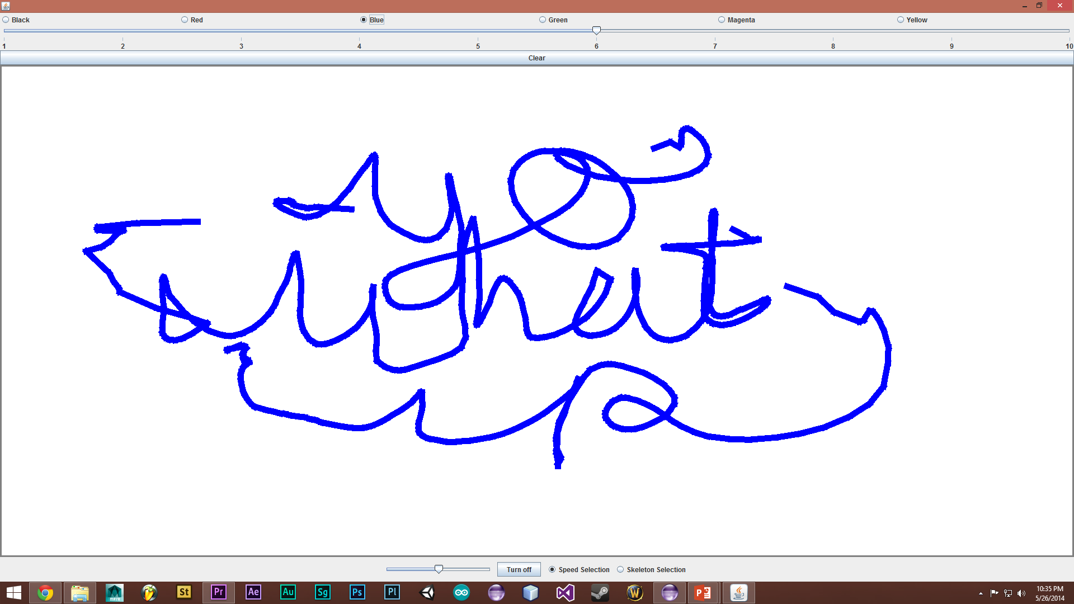
What is the Program?
Use your hands to paint on the canvas
To select in speed mode, flick your hand forward and flick it backward to deselect.
To select in skeleton mode, simply move your hand forward a
certain amount

Slide 4
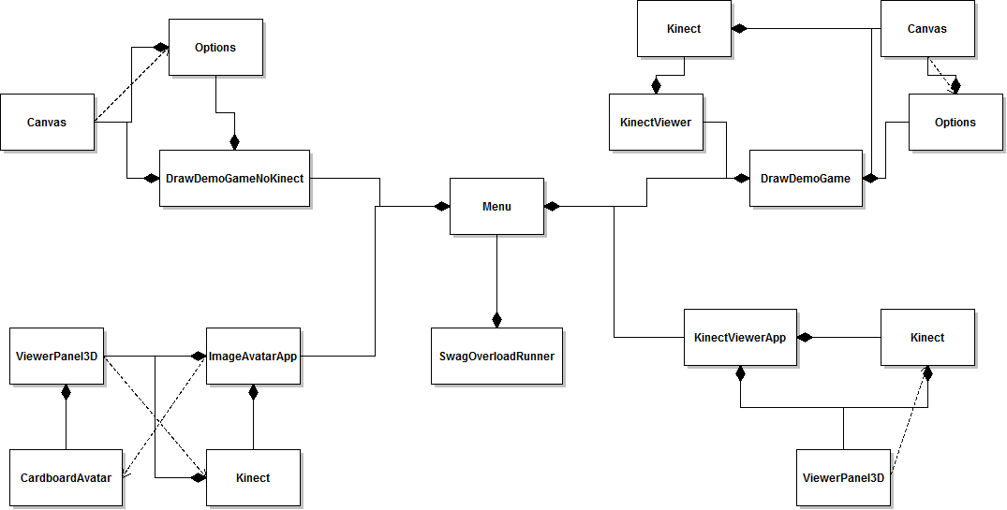
Our Program Blueprint
Include UML here

Slide 5
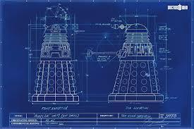
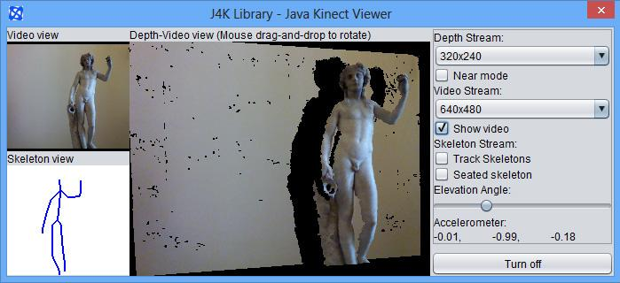
Design
J4K
DrawDemoGame
Kinect Implementation
Jogamp

Slide 6
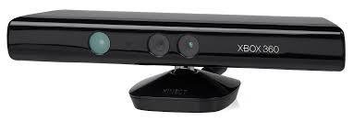
Challenges
Everything That Includes the Kinect

Slide 7
Time to Play… Finally!
Open the zip…
Play Mouse Version
Bugs
Sometimes kinect data “wonks out”
Kinect must be turned off before the window is closed

Slide 8
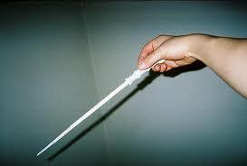
How to Paint
Speed Selection
Flick wrist to start painting
Flick again to stop
Skeleton Selection
Measures difference of Z-Coord between hand & head

Slide 9

If Only We Had More Time...
More Mini Games
Shooter game
Puzzle
Smoother gestures
and more features

